Slide 1


Join the Maker’s Club!

Slide 2
Maker's Club Meetings
Learn about CAD Modelling,
S&E Room 249B at 7:30 PM

Slide 3
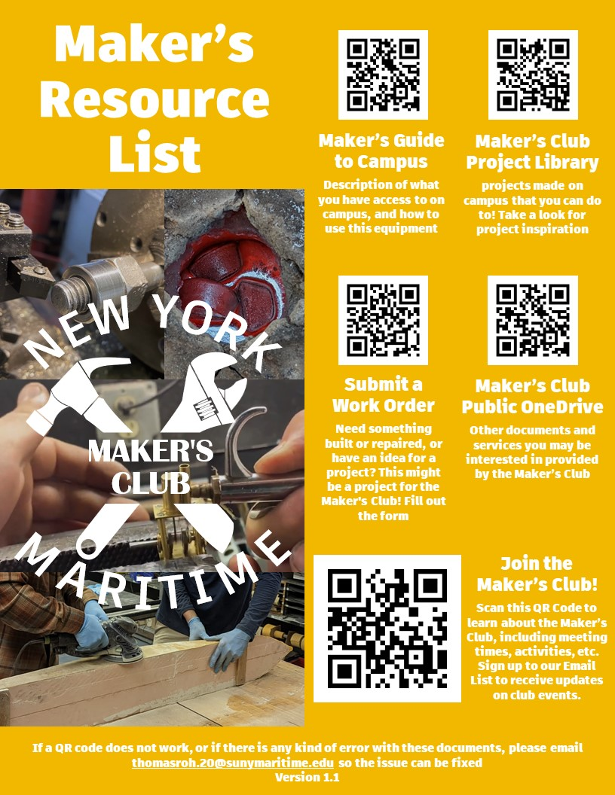
Need to use a machine space?
Information can be found on leaflets around campus

Slide 4
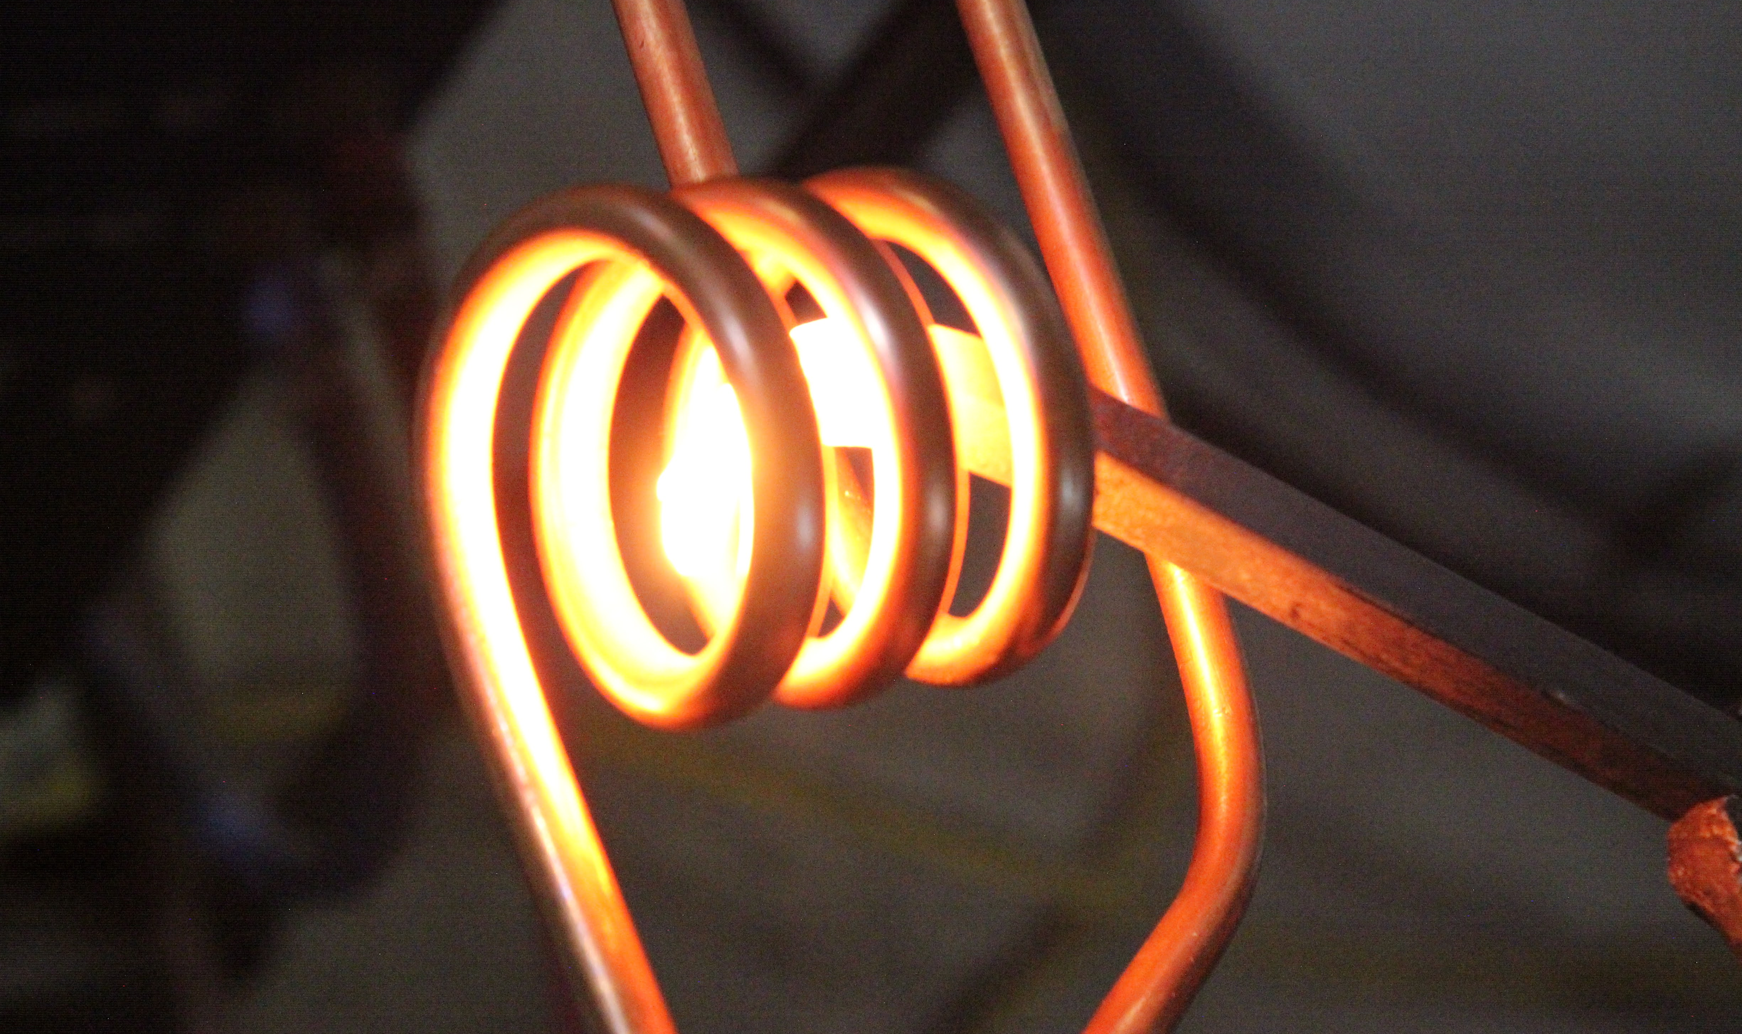
Blacksmithing Class at Makerspace NYC

Slide 5
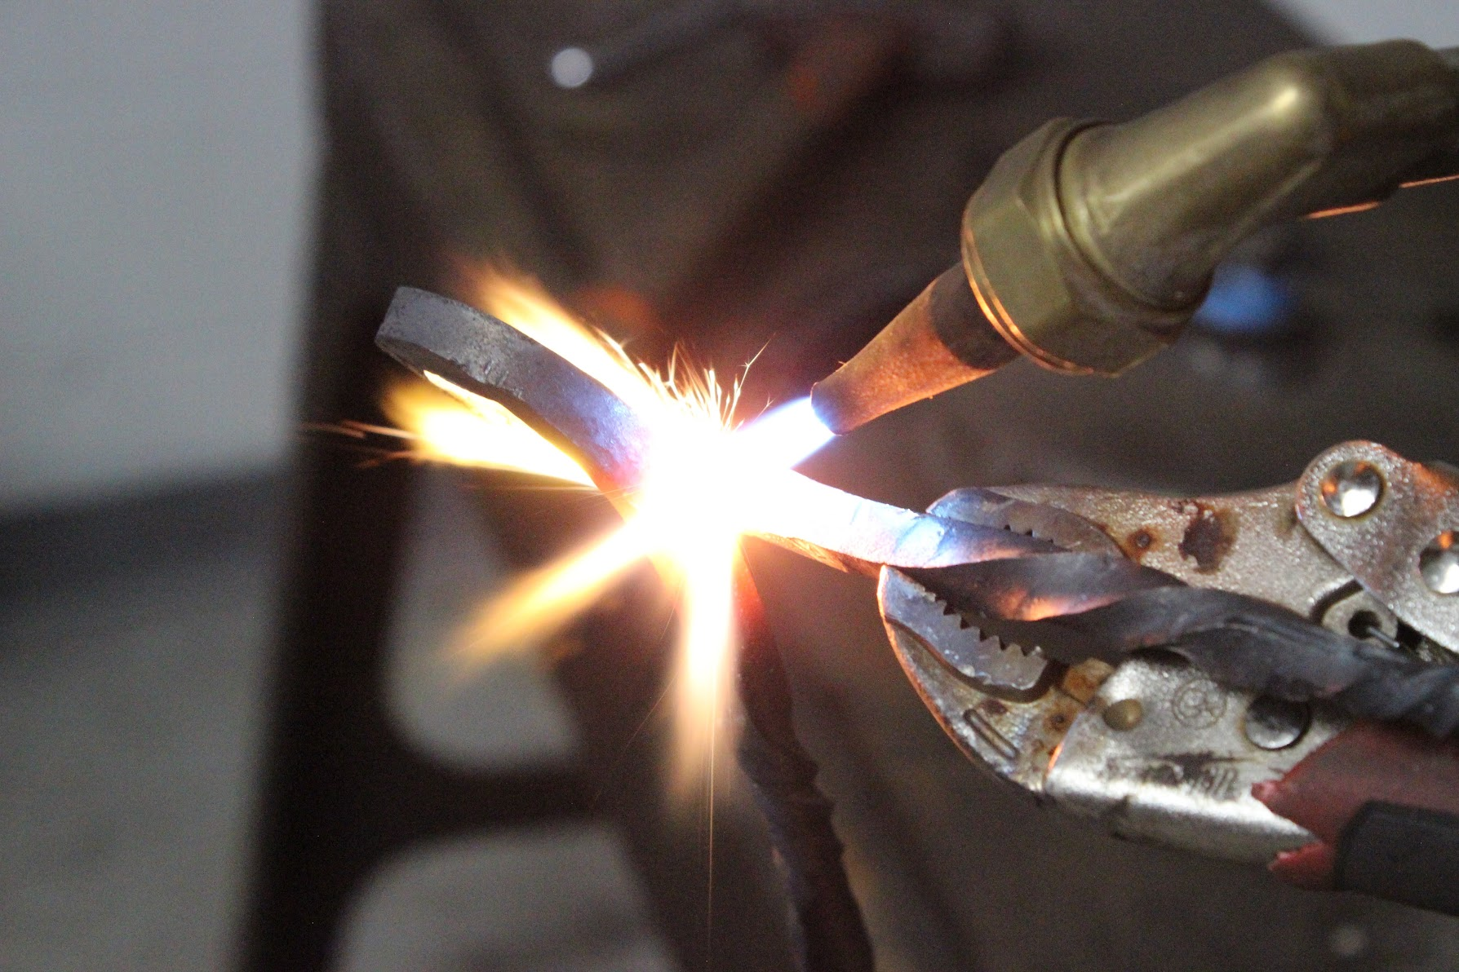

Slide 6
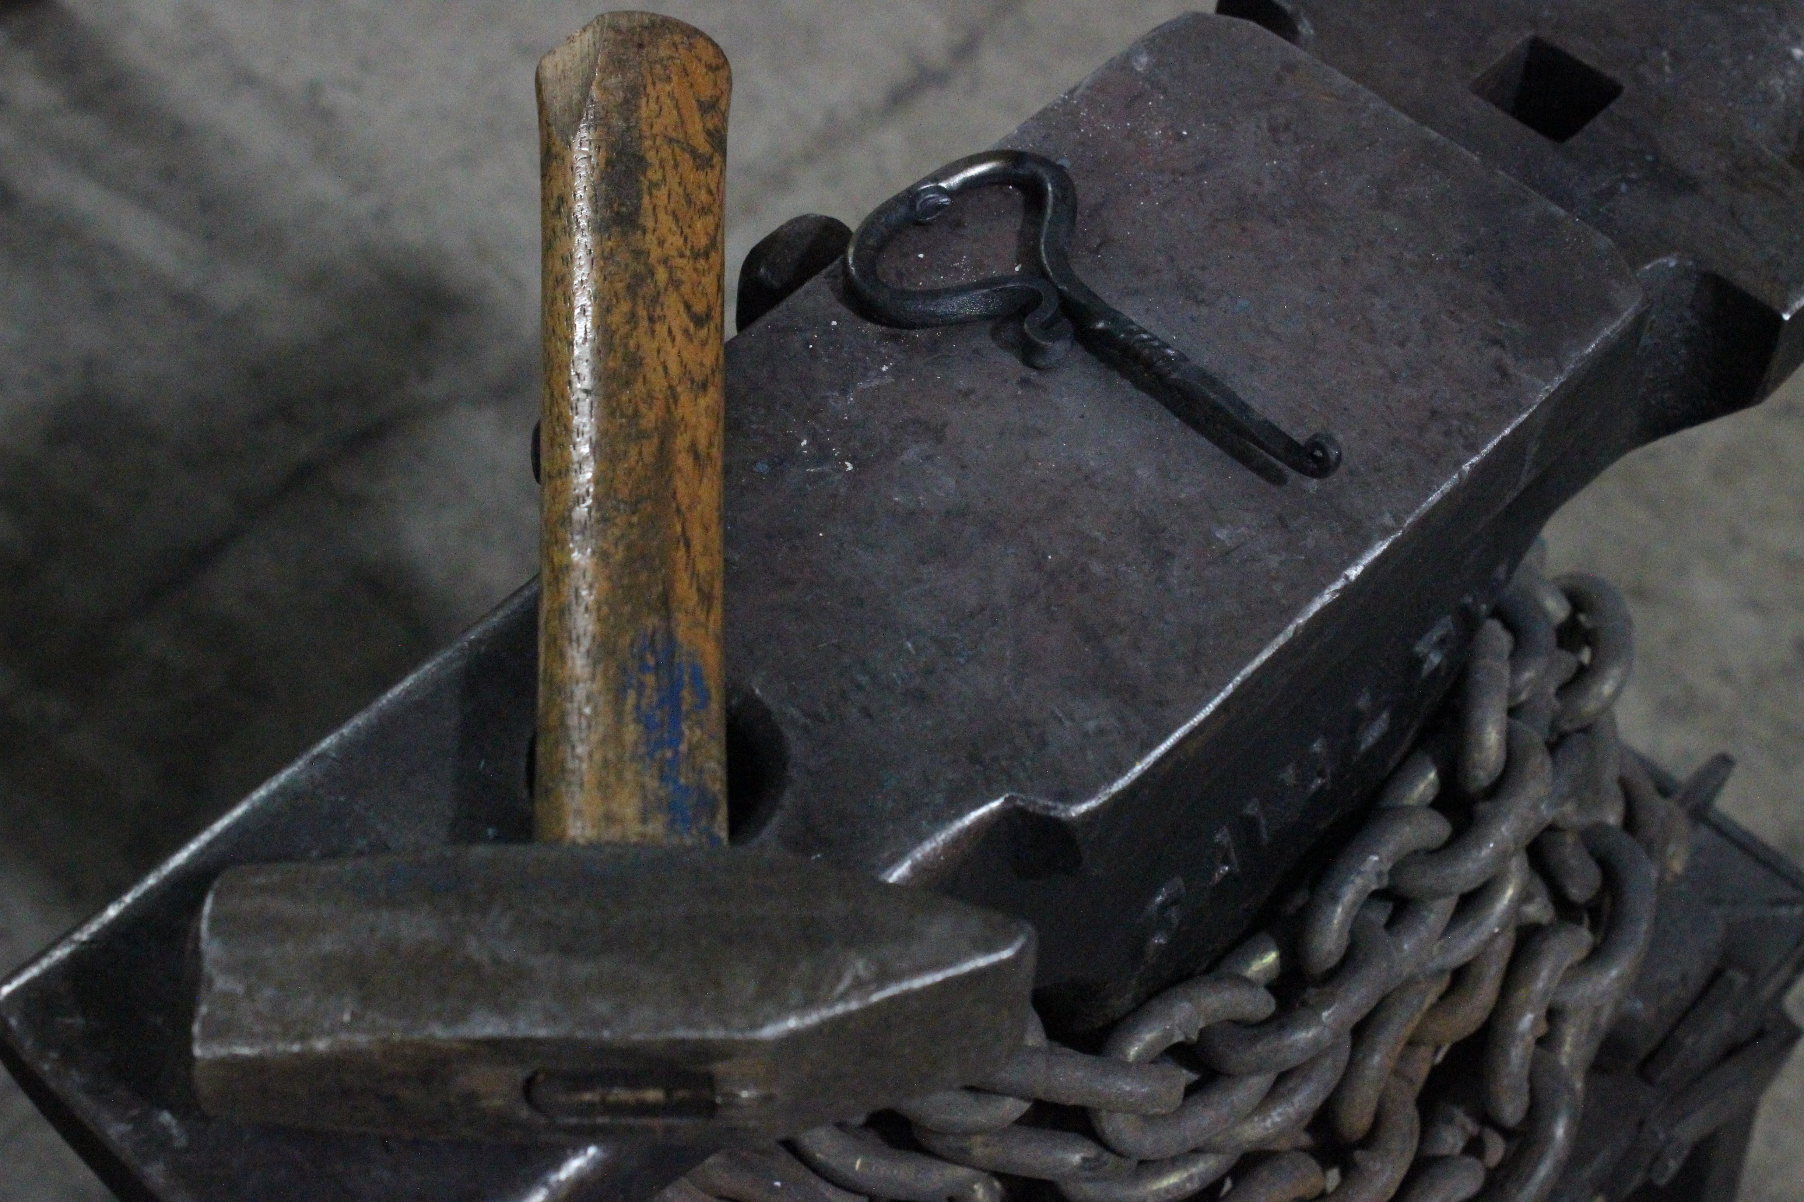

Slide 7
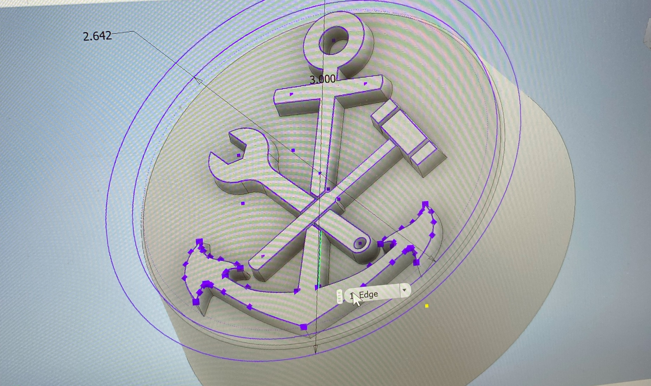

Slide 8
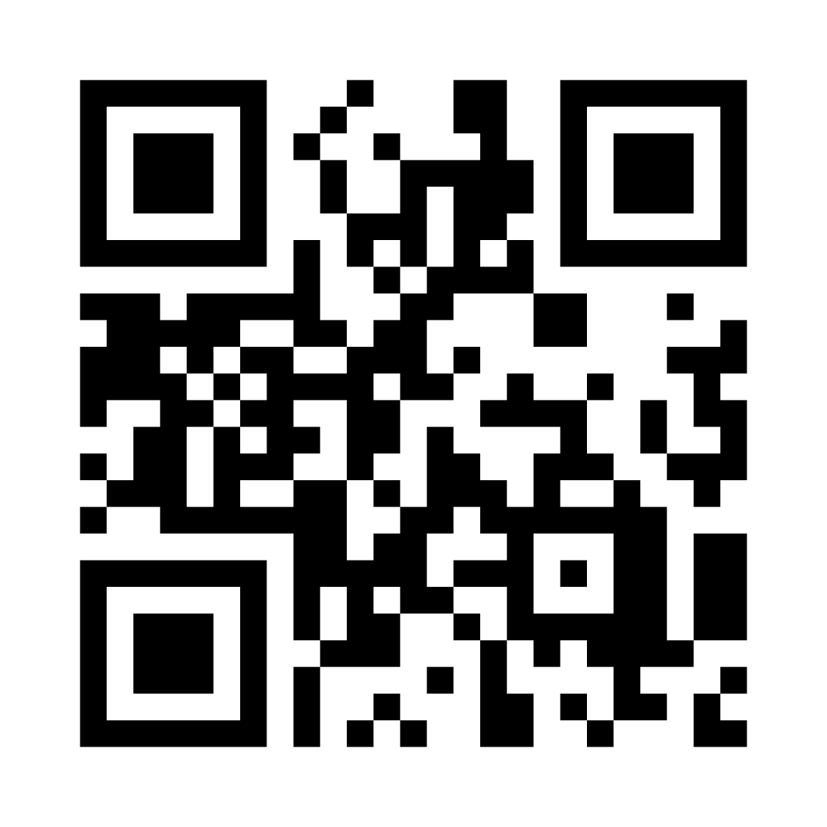
Follow the QR Code to get on the Maker's Club email list for project updates

Slide 9
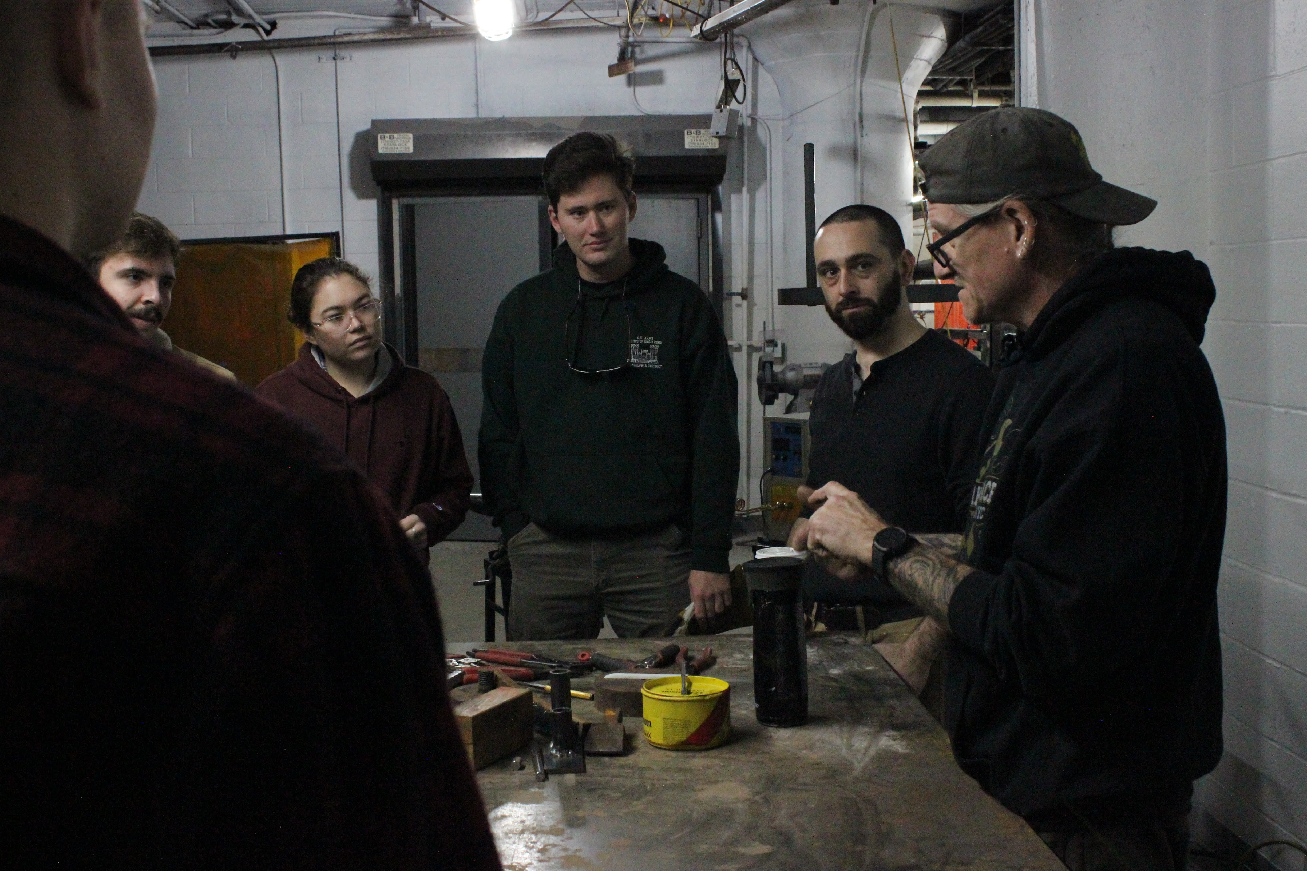
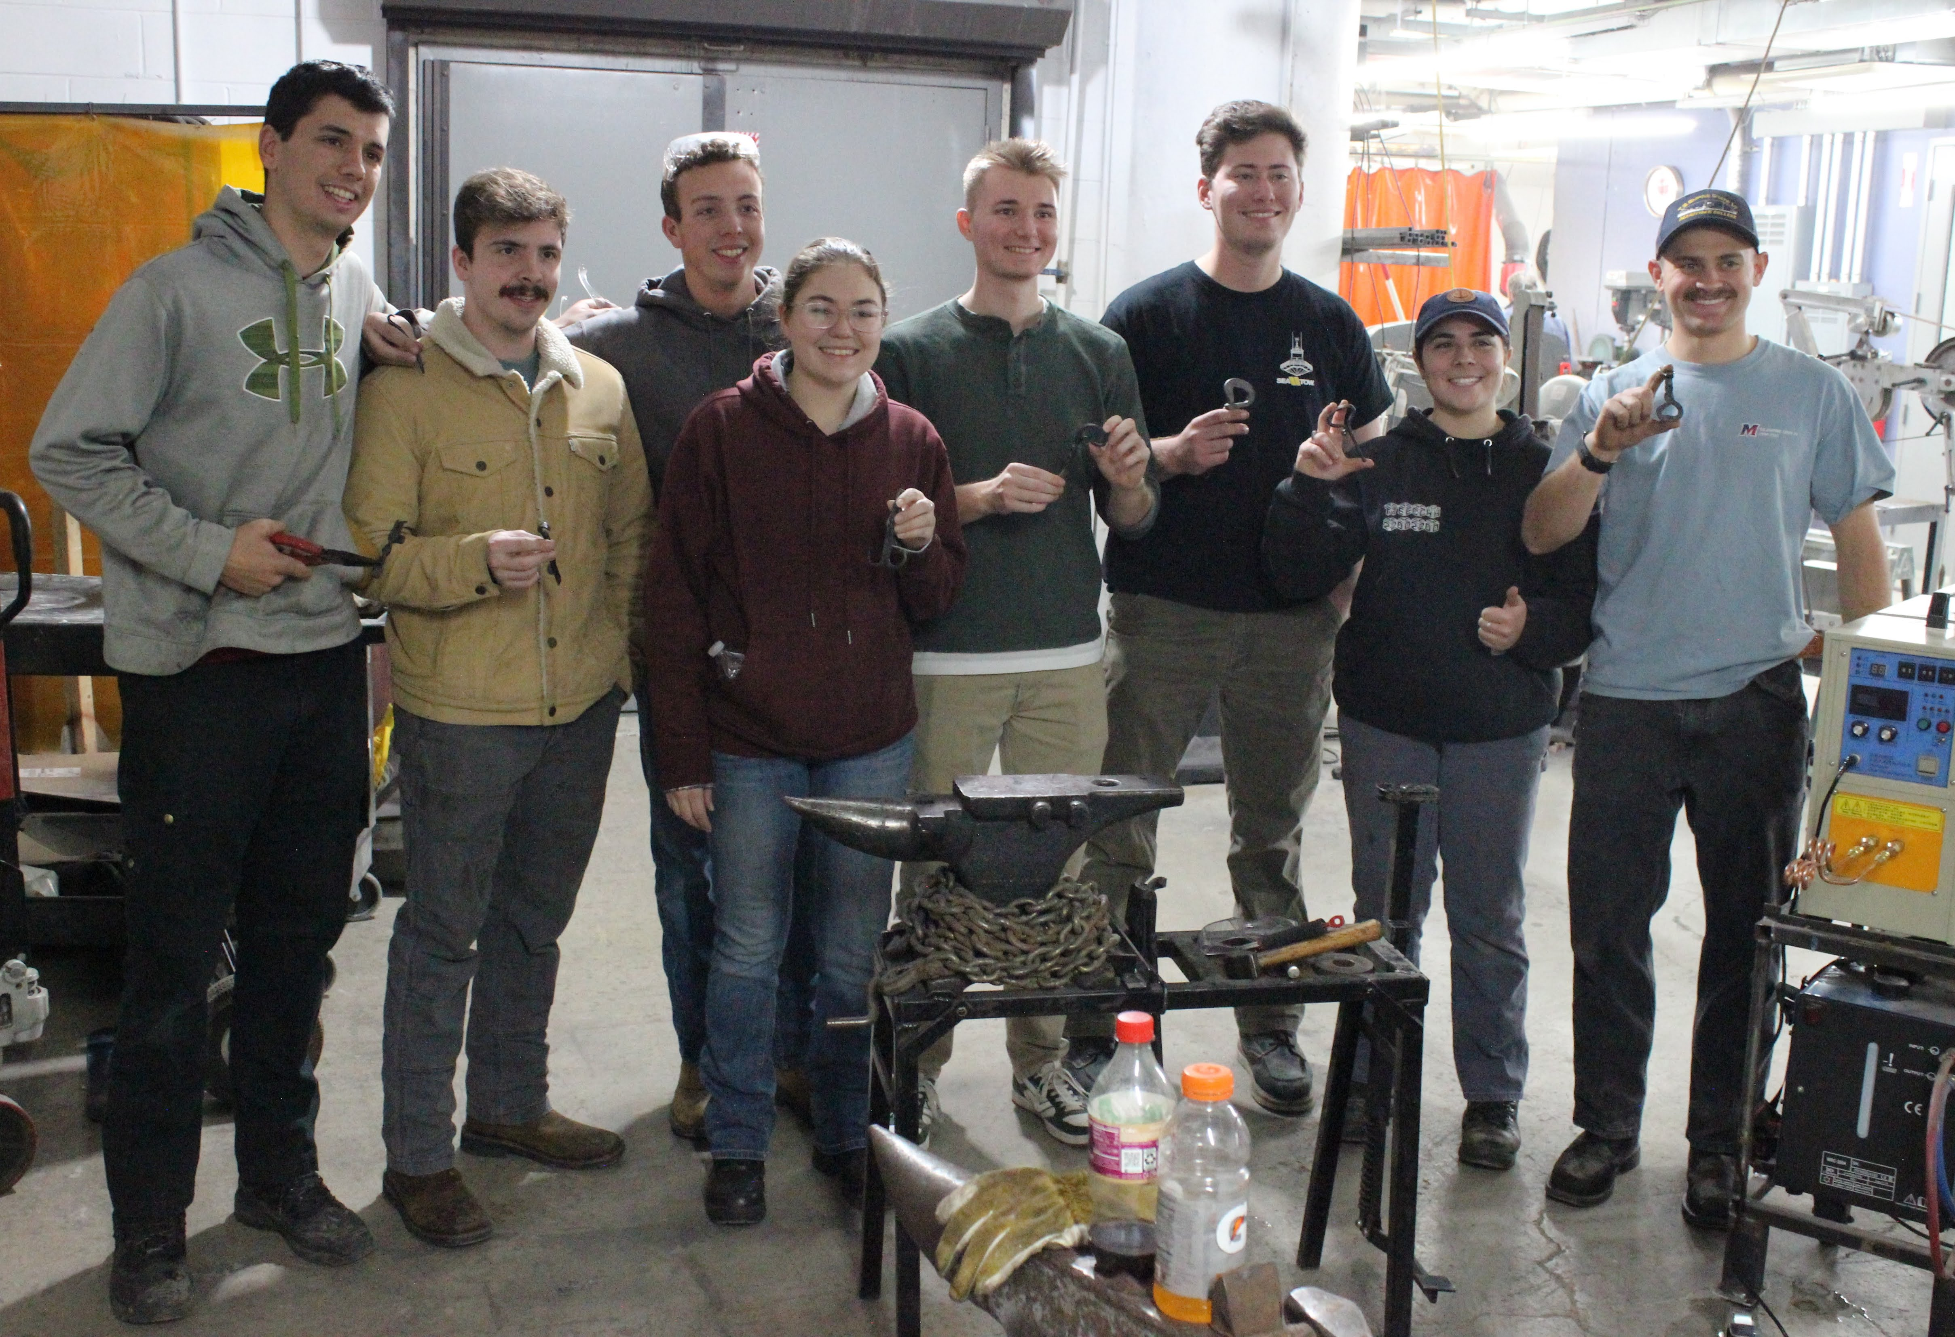

Slide 10
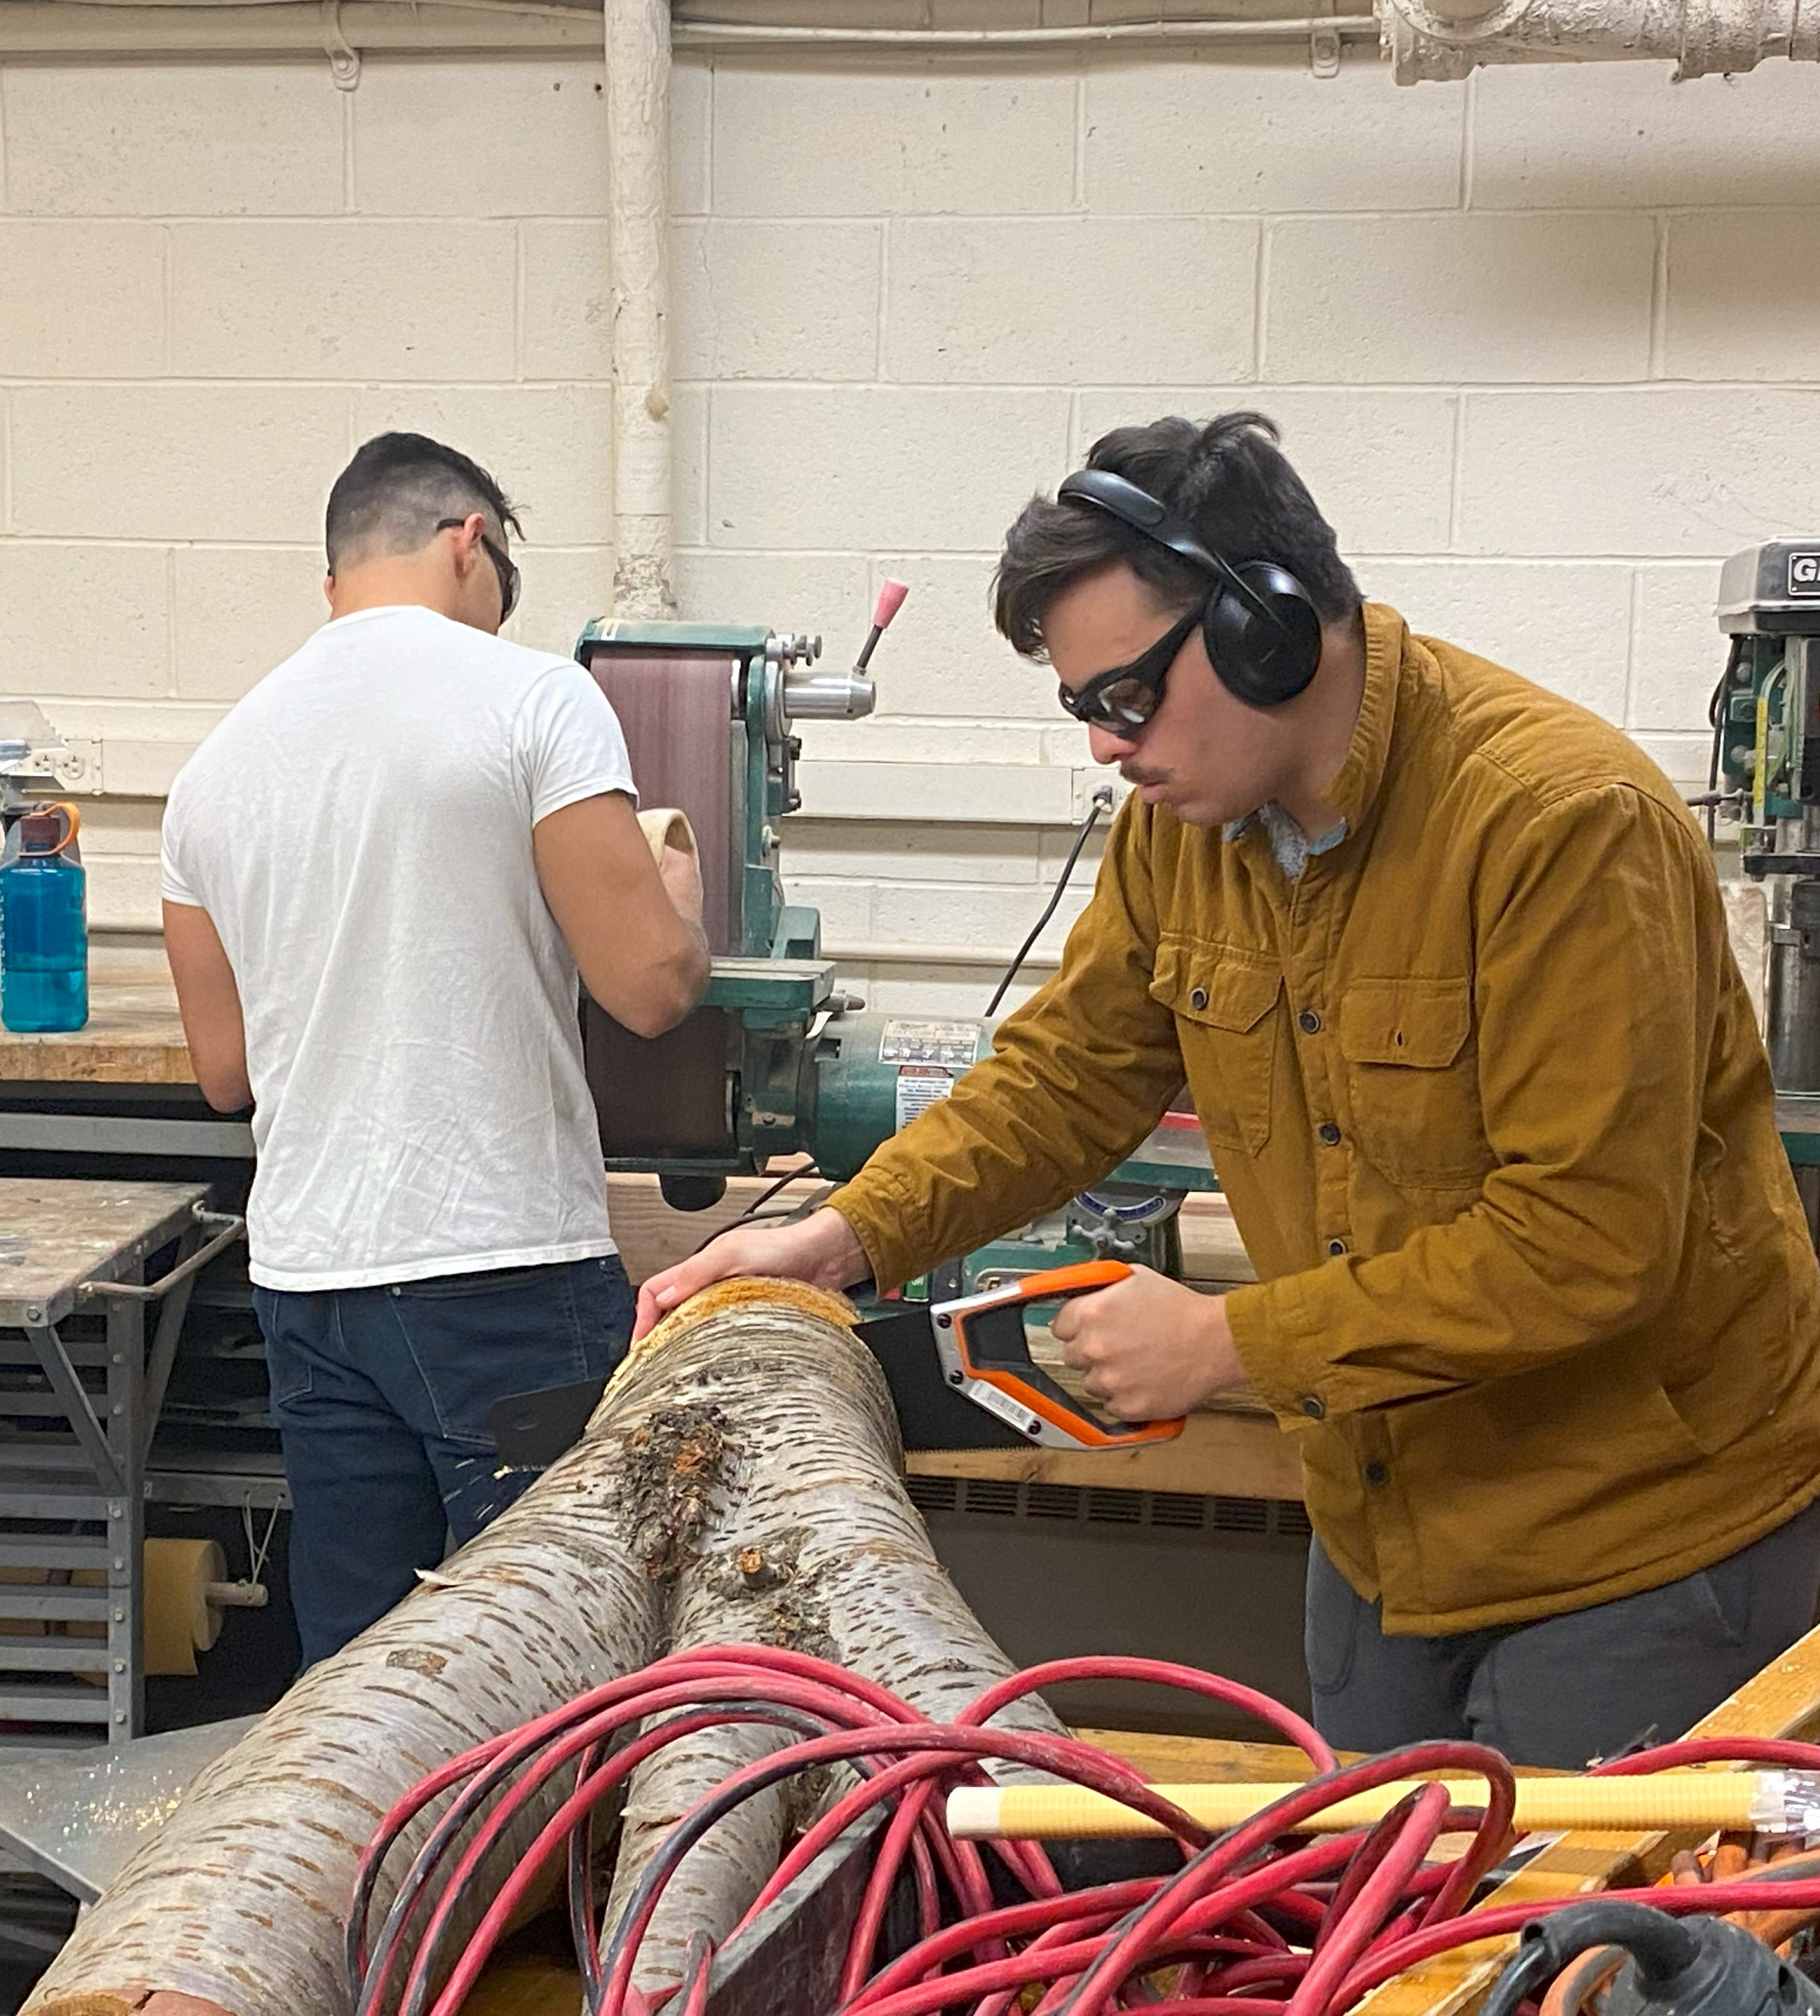
Come on down to the Wood Shop
Join the Maker's Club

Slide 11
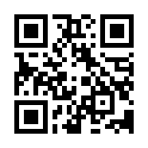
Did you know the Maker's Club had a website?
See what's new, at
nymmakersclub.com

Slide 12
Want to get involved with the Maker's Cub?
Follow the QR Code to see the Maker's Club Event Schedule

